Slide 1

IT TICKETING SYSTEM - VISTA-EMPOWER-2025-01
Scheduled on 09th June2025
Notes:
1
21.4.2022

Slide 2
OBJECTIVE
To develop a secure, scalable, and user-friendly web application that streamlines IT support workflows by automating ticket management, improving communication between users and IT staff, and providing actionable insights through analytics.
SCOPE
User Management
Secure authentication (JWT) for three roles: Admin, IT Staff, and Employees.
Role-based access control (RBAC) to restrict features based on permissions.

Slide 3
Ticket Lifecycle Automation
Users can create tickets (e.g., "Printer not working").
IT staff can prioritize and resolve tickets with status updates (Open, Closed).
Real-Time Communication
Email/SMS notifications for ticket updates .

Slide 4
Benefits for VISTA
1. Automated Auditing & Compliance
Benefit: Eliminates manual tracking by automatically auditing every ticket stored in AWS S3 (e.g., logs, attachments, resolutions).
Impact: Ensures 100% ticket accountability (no lost/ignored tickets).
2. IT Staff Performance Analytics
Benefit: Admins can track KPIs like:
Tickets resolved per employee (identify top performers/bottlenecks).

Slide 5
PROGRAMS AND SOFTWARE
STACK: MERN (MongoDB, Express, React, Node)
Libraries:
Backend: bcrypt, body-parser, cors, dotenv, express, jsonwebtoken, mongodb, mongoose, nodemailer, nodemon, password-validator
Frontend: antd, axios, lucide-react, react, react-dom, react-hook-form, react-router-dom, recharts, yup

Slide 6
SCALABLE OPTIONS
Cloud-Native Architecture
AWS S3 Integration:
Automatically archives all tickets with metadata (audit-ready)
Scales storage seamlessly (no downtime during peak loads).
Containerization Support:
Docker/Kubernetes-ready for easy deployment across global teams.

Slide 7
SCHEDULE
Phase 1: Planning & Setup
Requirements Gathering
Define user roles, ticket workflows, and KPIs.
Tech Stack Finalization
MERN stack setup (MongoDB Atlas, Express.js, React, Node.js).
Project Charter Approval
Sign off on scope, objectives, and timelines.

Slide 8
SCHEDULE
Phase 2: Backend Development
Database Design: MongoDB schema for Users, Tickets, Departments.
API Development
RESTful endpoints for:
Authentication (JWT).
Ticket CRUD operations.
Admin analytics.
AWS S3 Integration
Ticket attachment storage/audit logs.

Slide 9
SCHEDULE
Phase 3: Frontend Development
Dashboard, ticket submission form, admin panels.
React Components
Ticket list, user profile, real-time notifications.
State Management
Redux/Context API for global state (e.g., user sessions).

Slide 10
SCHEDULE
Phase 4: Testing & QA
Unit Testing
Jest (Backend), React Testing Library (Frontend).
User Acceptance Testing (UAT)
Feedback from IT staff/end-users.

Slide 11
CURRENT STATUS
95 finished.
Containerization(Docker), Testing yet to be done.

Slide 12
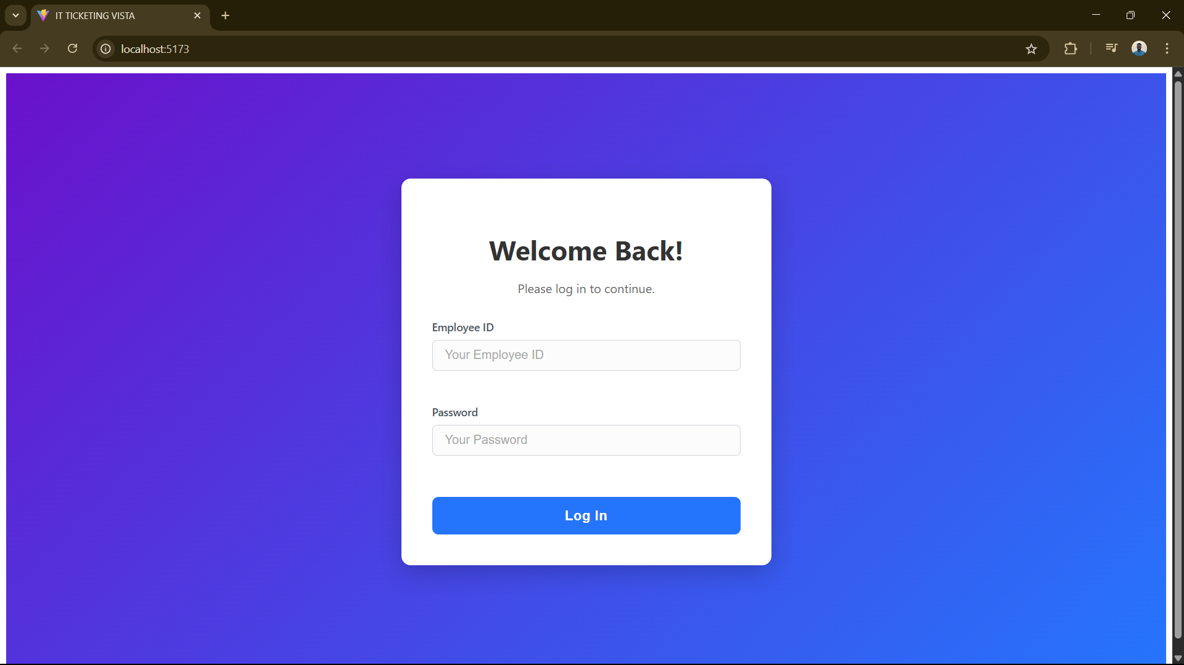
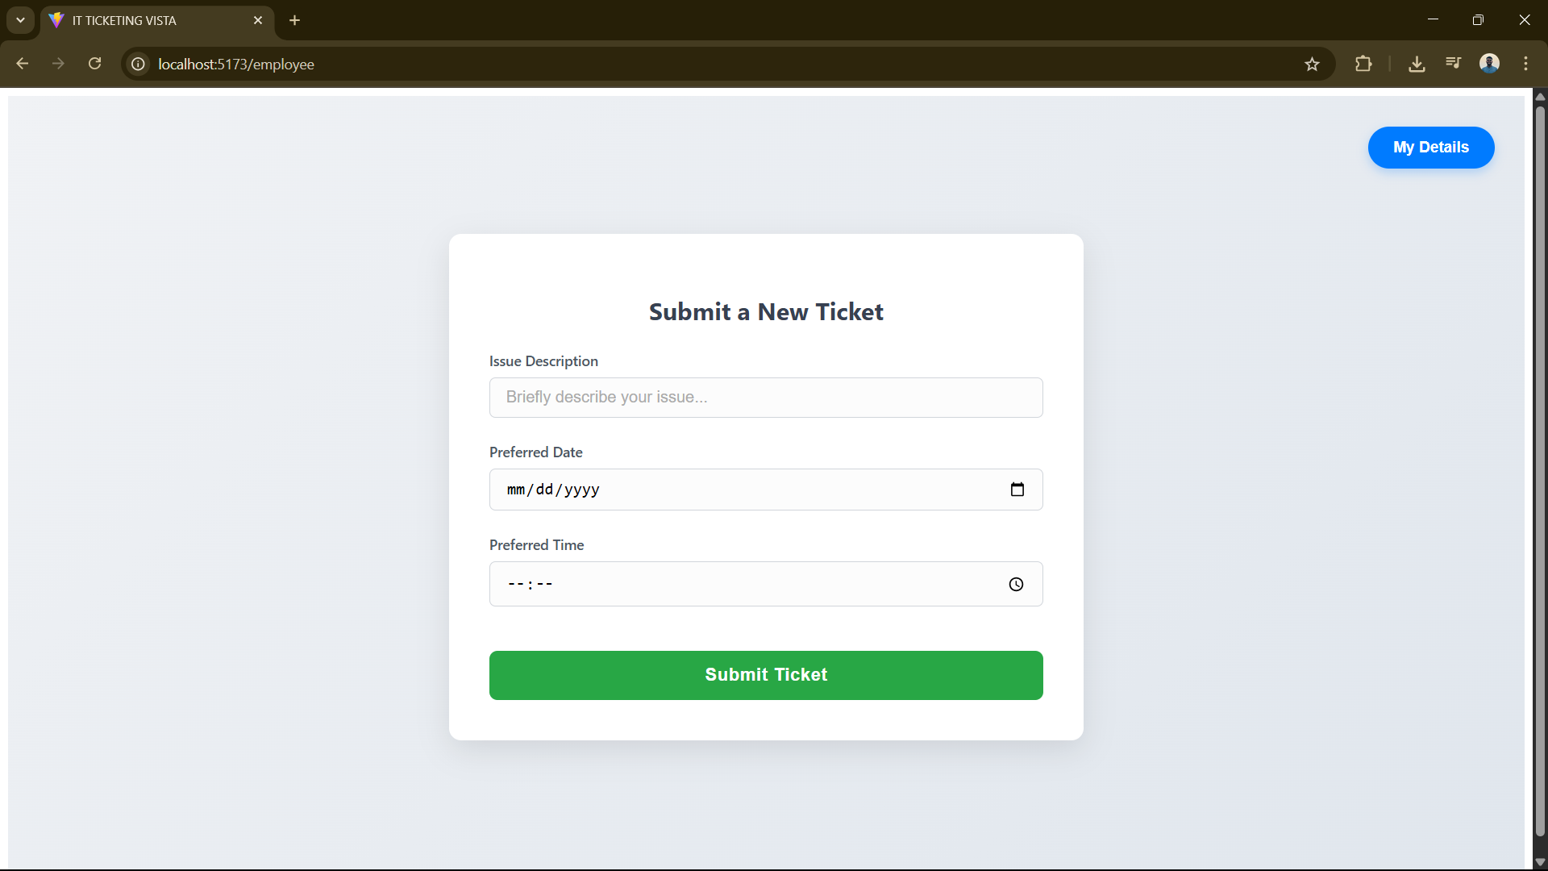
SNAPSHOTS

Slide 13
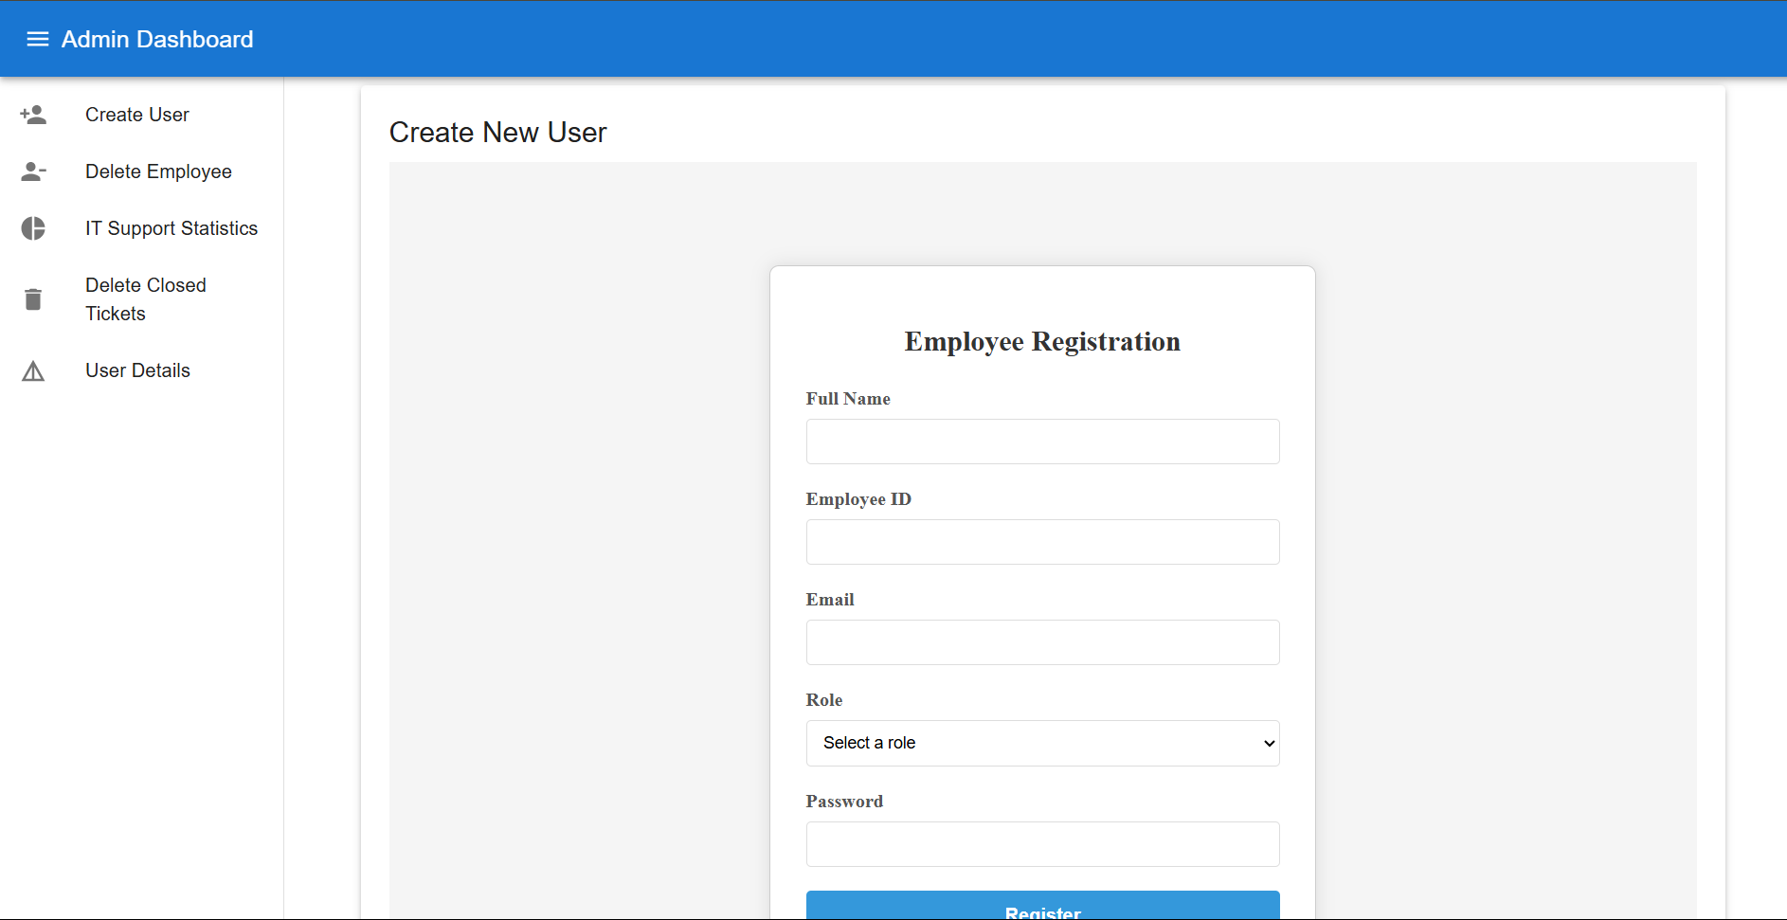
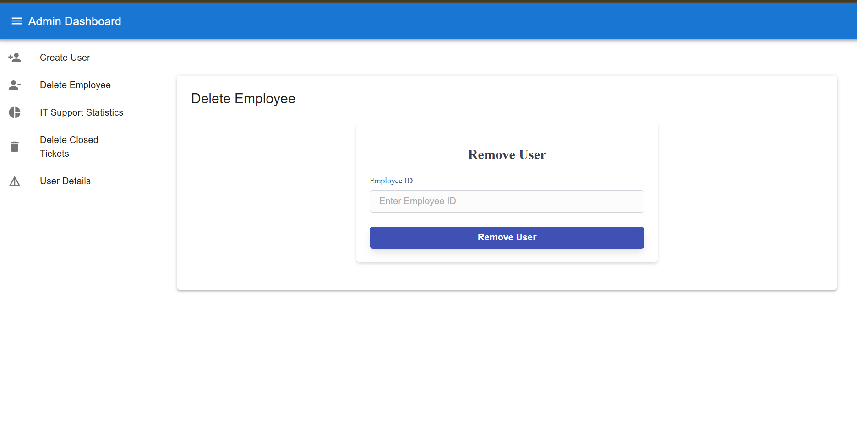
SNAPSHOTS

Slide 14
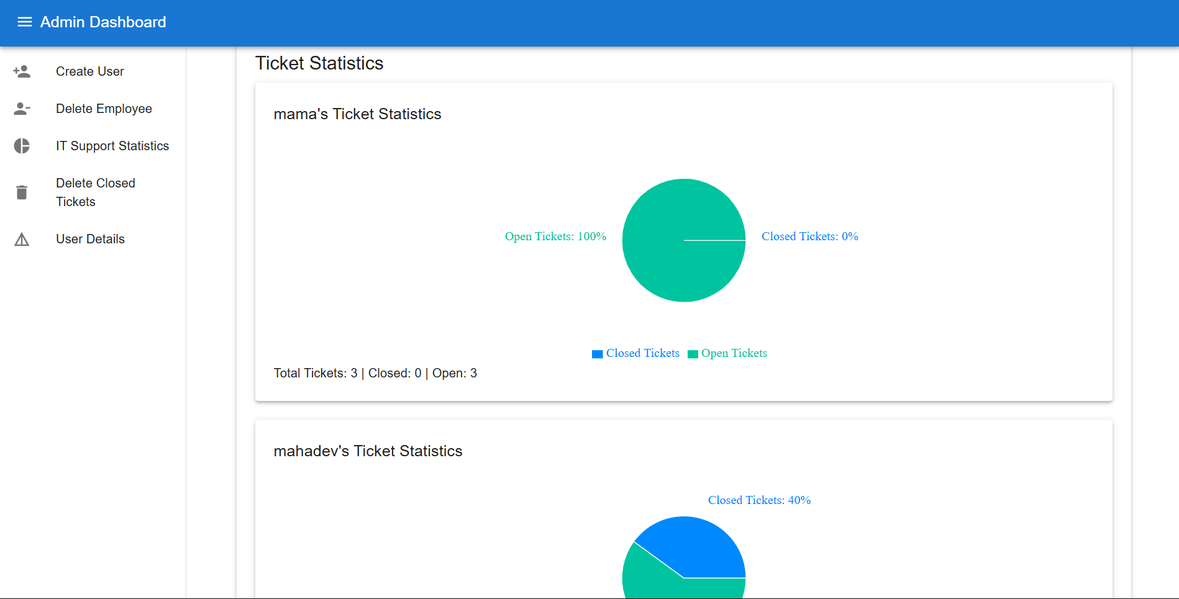
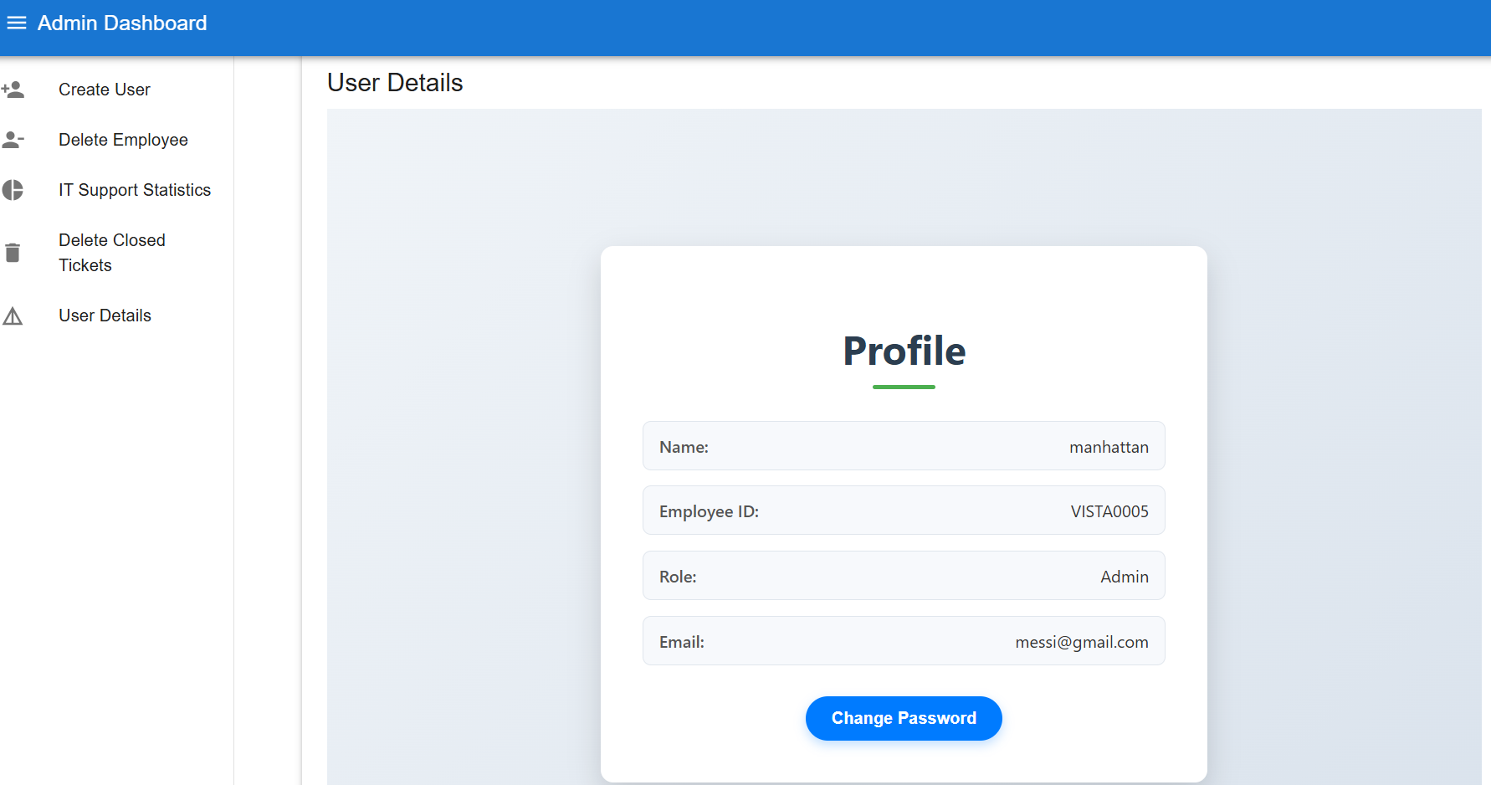
SNAPSHOTS

Slide 15
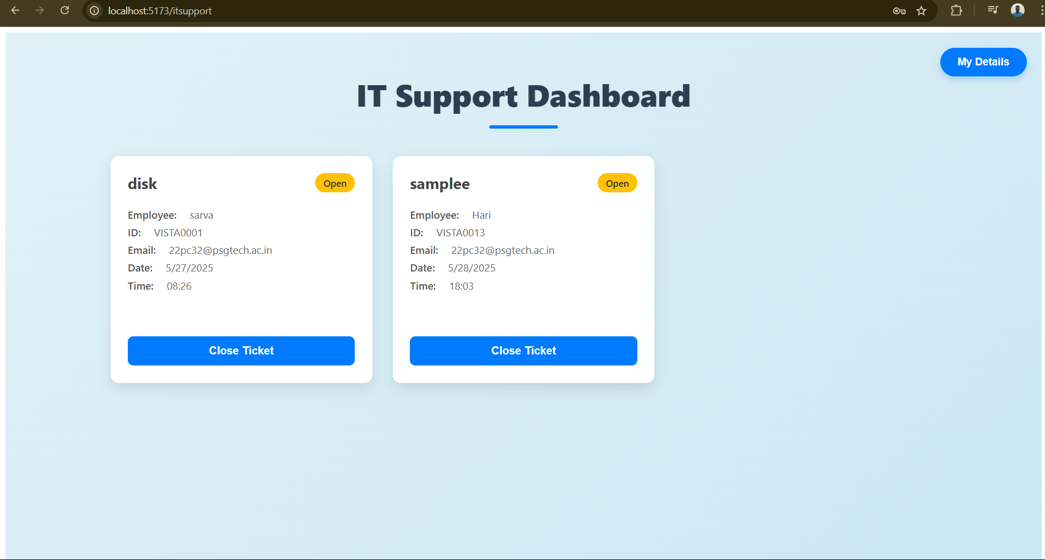
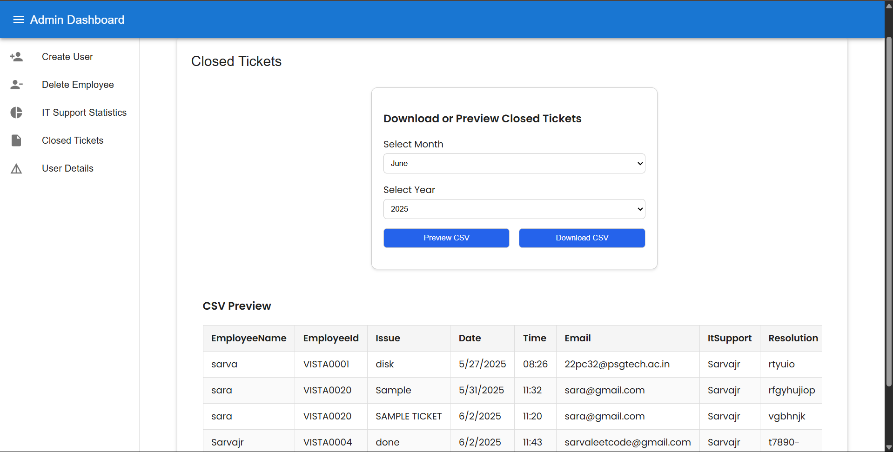
SNAPSHOTS

Slide 16
Conclusion
The IT ticketing system effectively streamlines the process of reporting, tracking, and resolving technical issues within an organization. By providing a centralized platform for users to submit tickets and for IT teams to manage them, the system enhances communication, boosts efficiency, and ensures timely resolution of issues. This project highlights the importance of technology in improving service delivery and supporting the overall productivity of an organization.

Slide 17
Thank You

